Slide 1
CONVOLUTION NEURAL NETWORK (CNN)

Slide 2
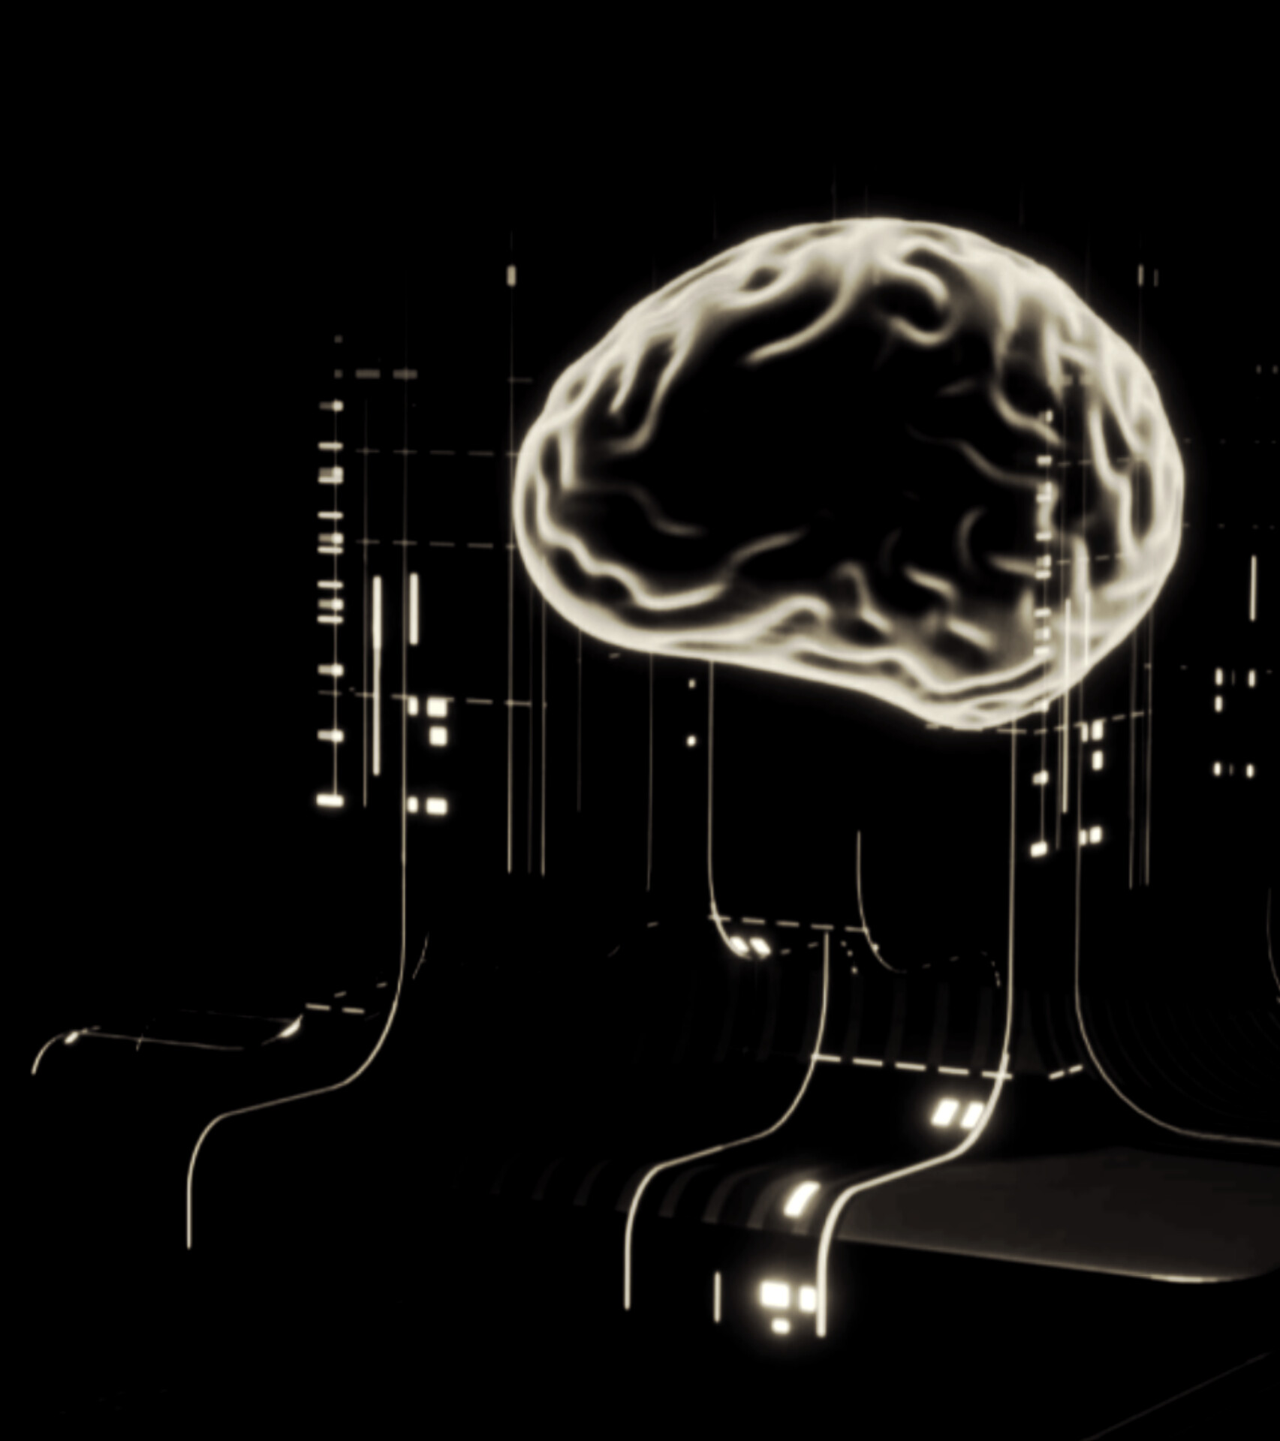
Contents
What is CNN
Working of CNN
Architecture of CNN
Applications of CNN
Conclusion

Slide 3
WHAT IS CNN?
CNN stands for Convolutional Neural Network, a type of artificial neural network that uses a mathematical operation called convolution to learn features from images. CNNs are a type of deep learning algorithm that are often used for image recognition and processing.
A deep learning algorithm primarily used for image recognition, computer vision, and pattern recognition tasks. CNNs consist of layers like convolutional layers, pooling layers, and fully connected layers, allowing them to automatically learn spatial hierarchies of features from images

Slide 4
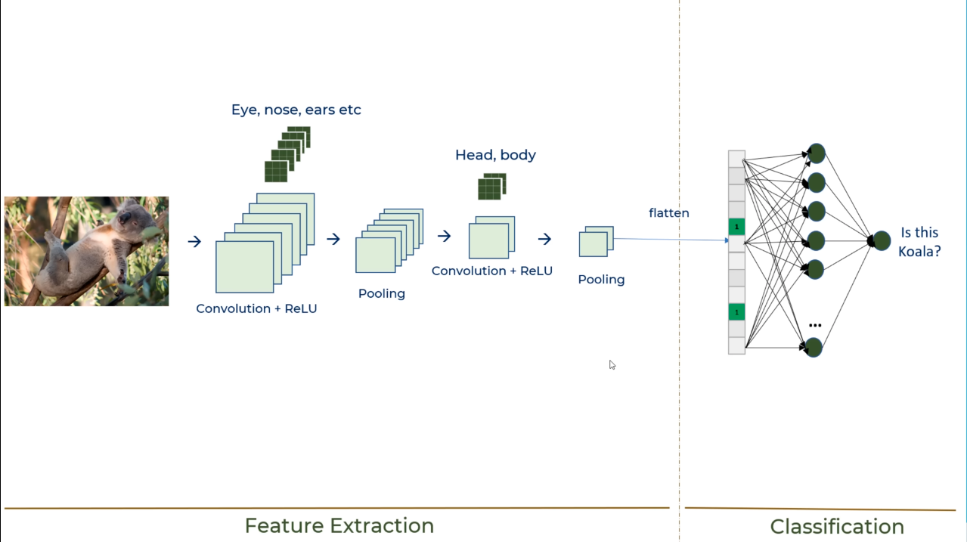
Architecture of CNN

Slide 5

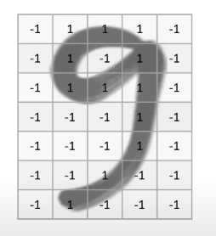
Working of CNN
→
grid
Hand Written no.

Slide 6
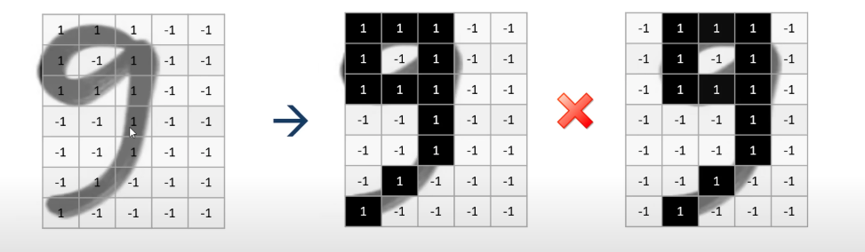
Location Shifted

Slide 7
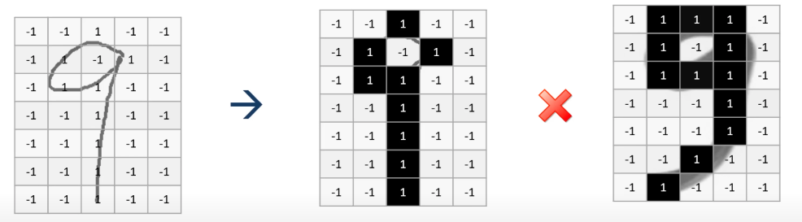
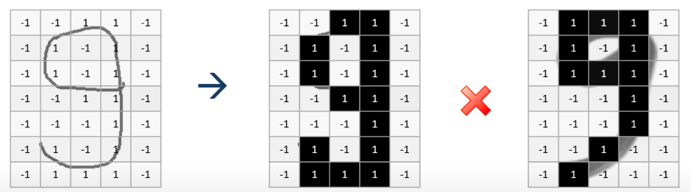
Variation -1
Variation -2

Slide 8
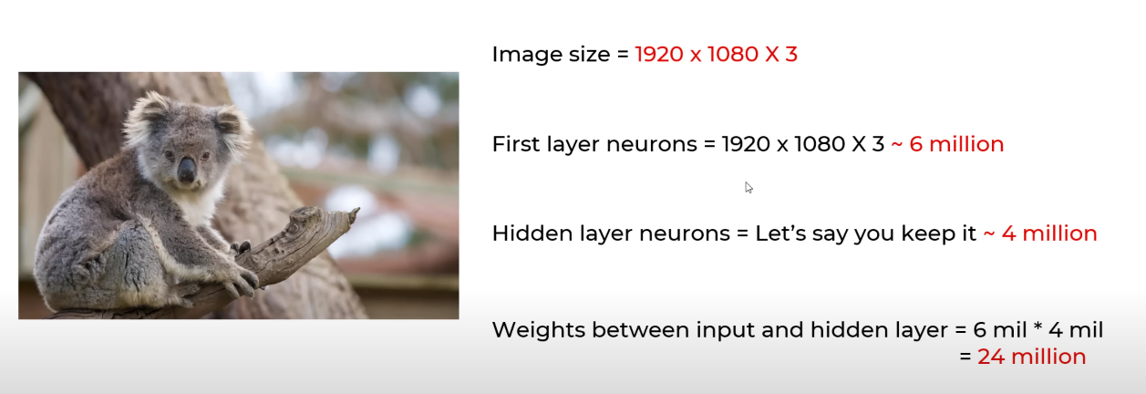
To Handle variety in digits we can use simple Artificial Neural Network(ANN)
Disadvantages of using ANN for image classification
1. Too much computation
2. Treats local pixels same as pixels far apart
3. Sensitive to location of an object in an image

Slide 9
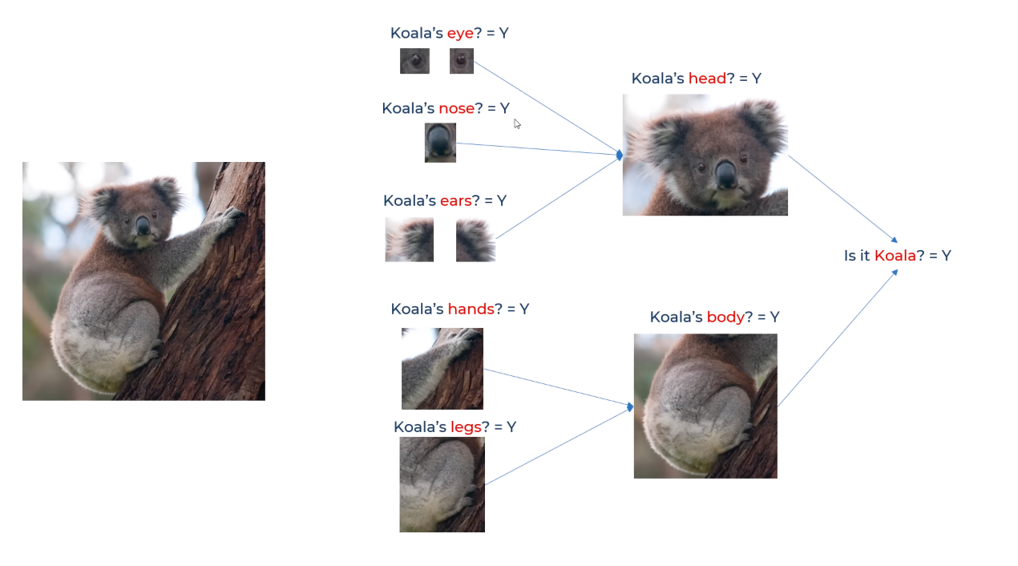
How we human can Recognize any images

Slide 10
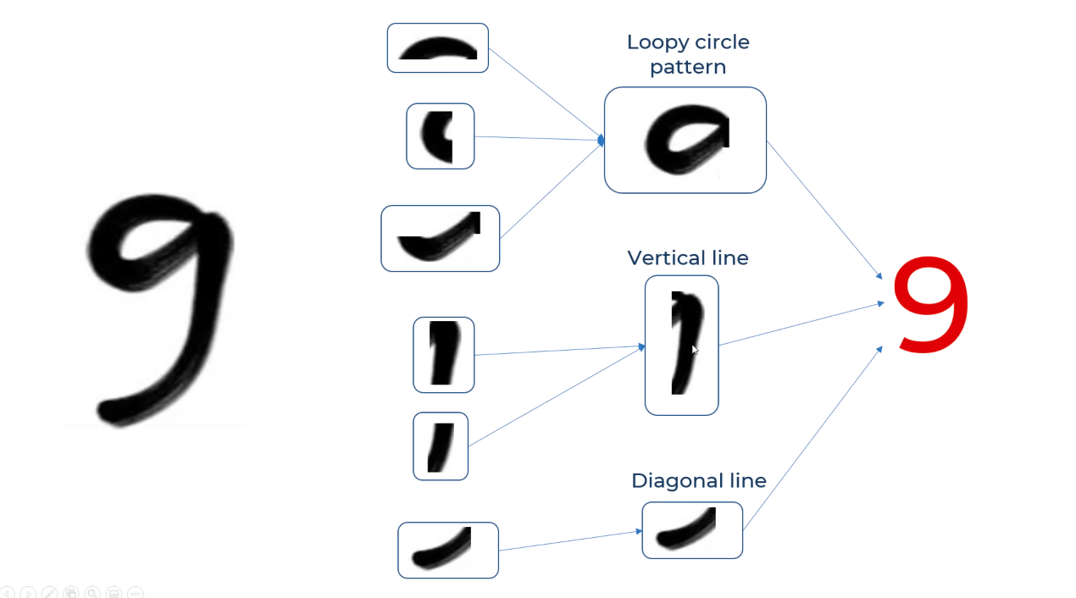

Slide 11
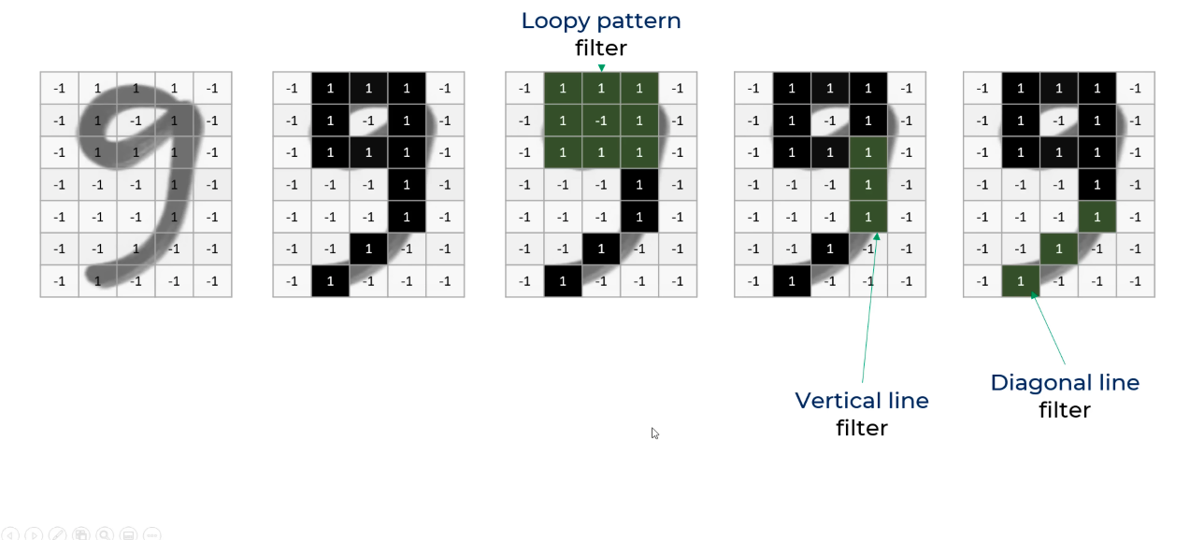
How computer recognize this tiny Features?

Slide 12
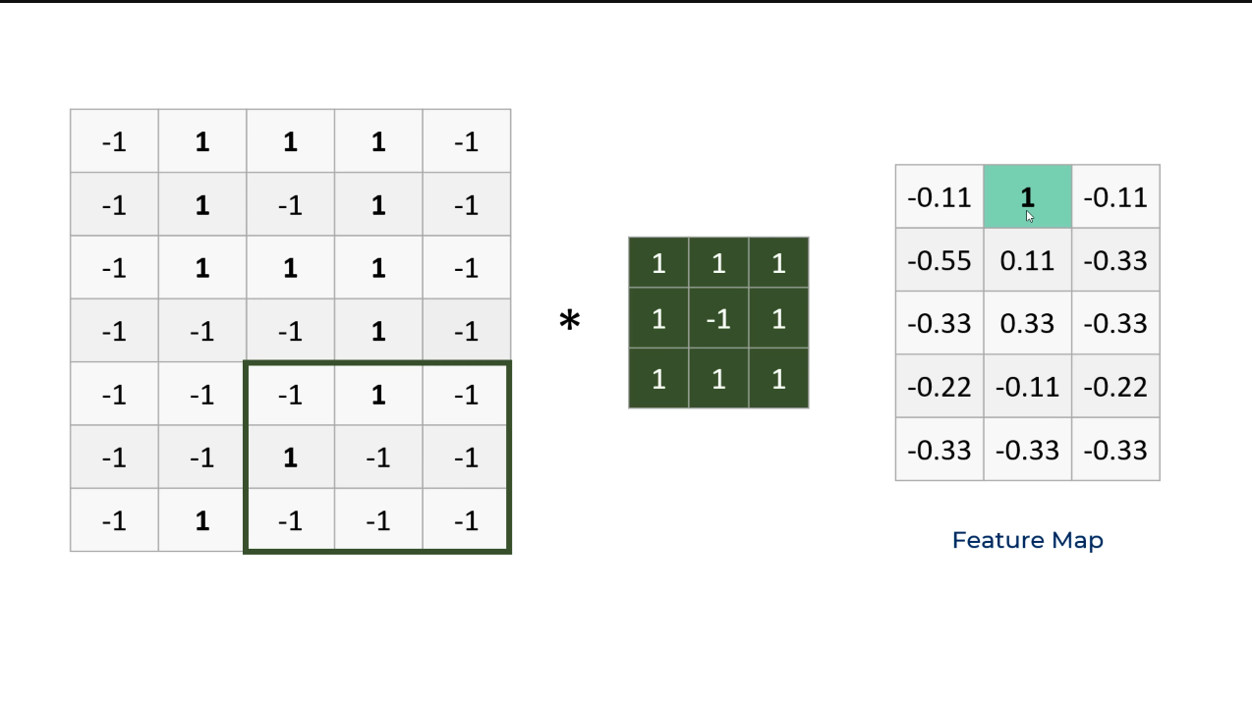
3x3 grid
Original Image

Slide 13
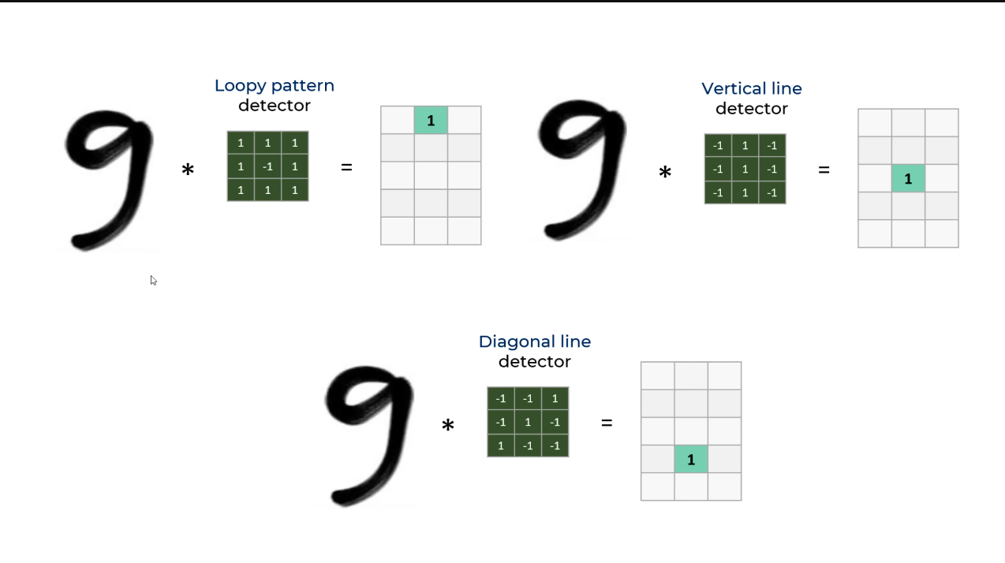

Slide 14
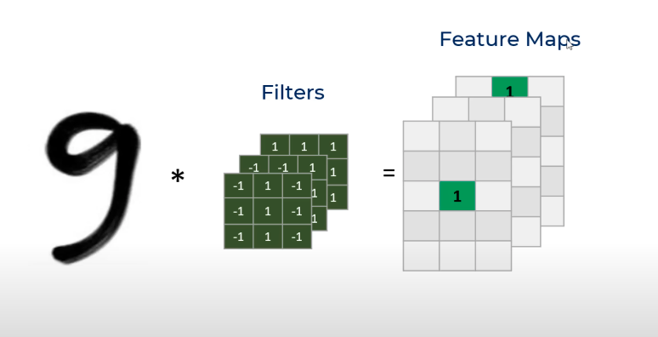

Slide 15
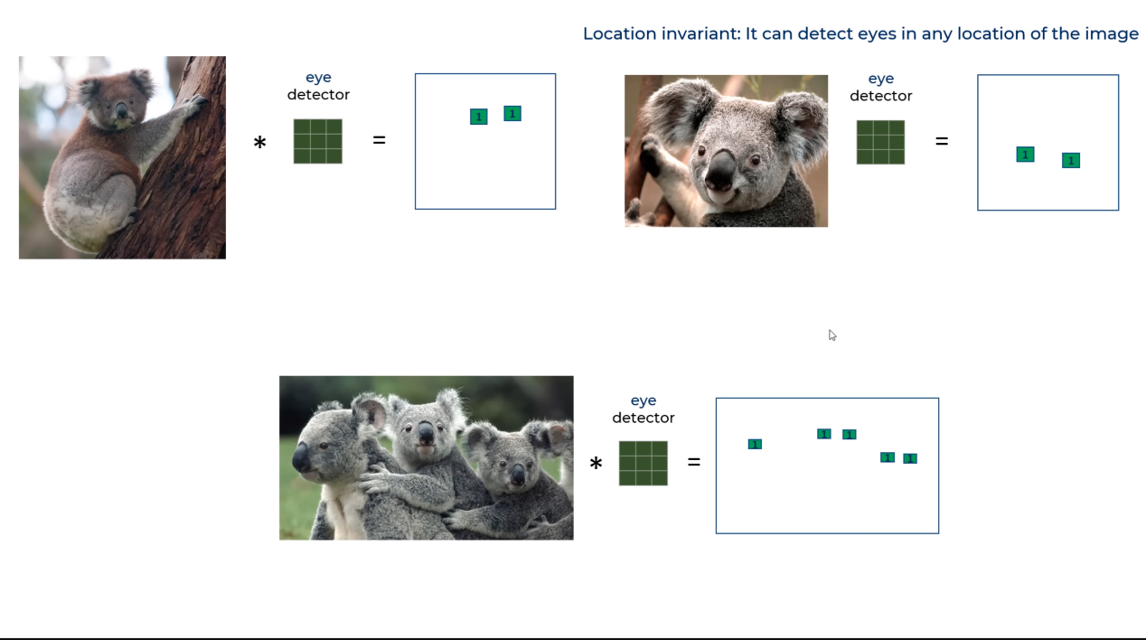

Slide 16
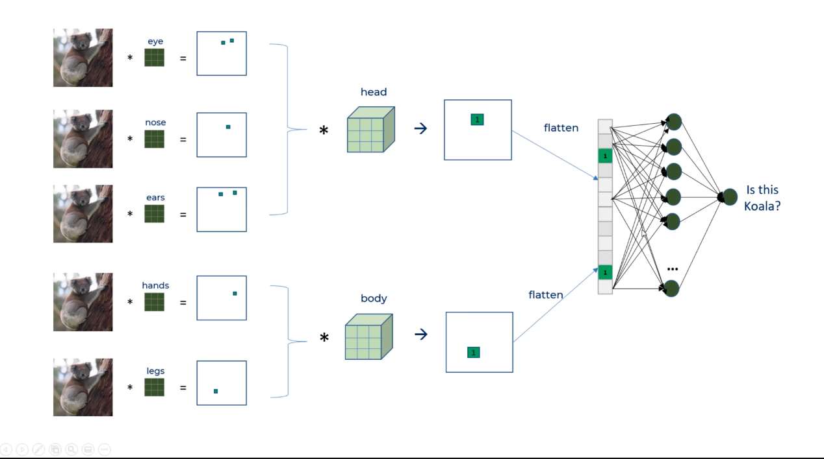
Fully connected neuron

Slide 17
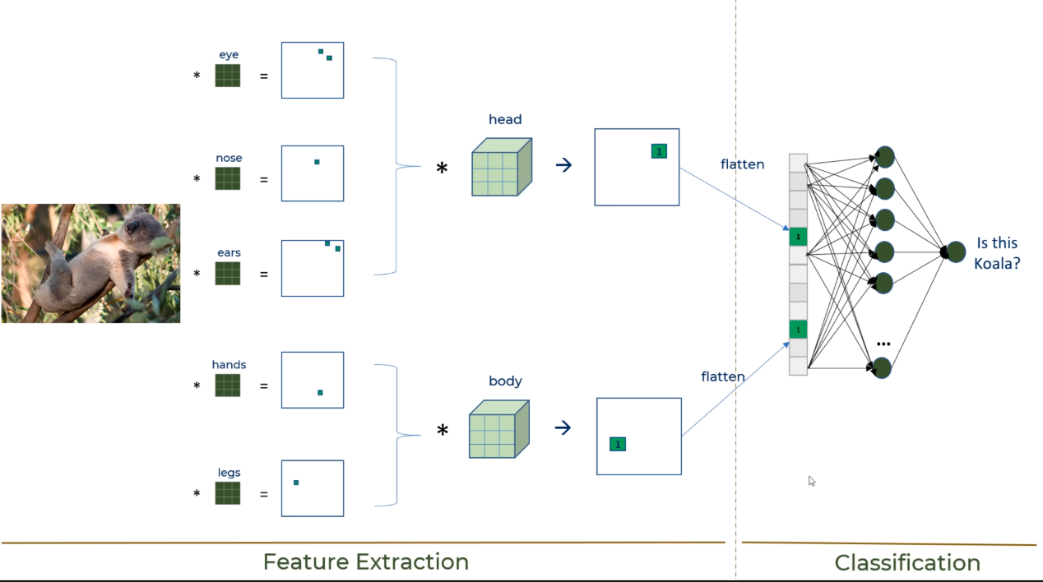

Slide 18
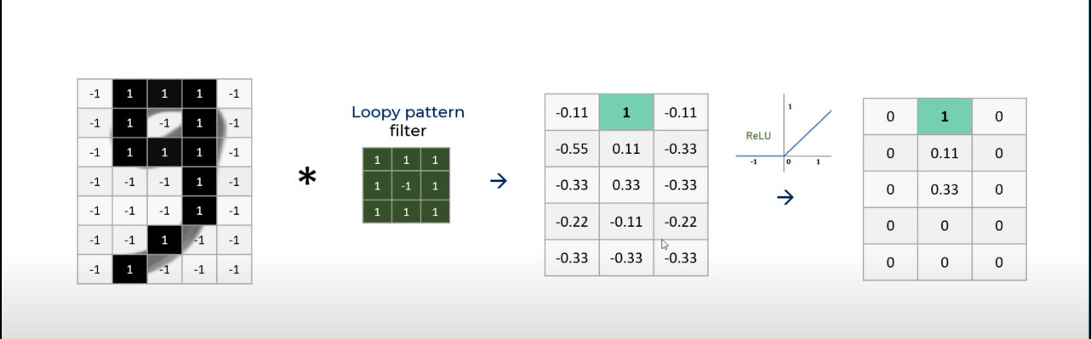
Activation: “relu”
ReLU Formula:
f(x)=max(0,x)
If x is positive, it remains the same.
If x is negative, it becomes
Feature map
Feature map

Slide 19
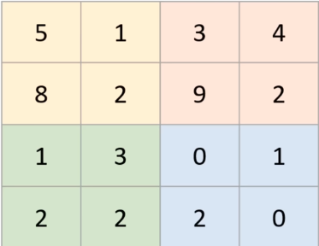
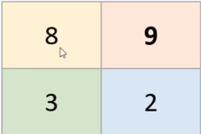
POOLING LAYER
A Pooling Layer is a key component in Convolutional Neural Networks (CNNs) used to reduce the spatial size of feature maps while retaining important information.
1. Max pooling

Slide 20
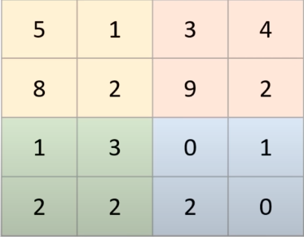
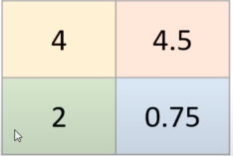
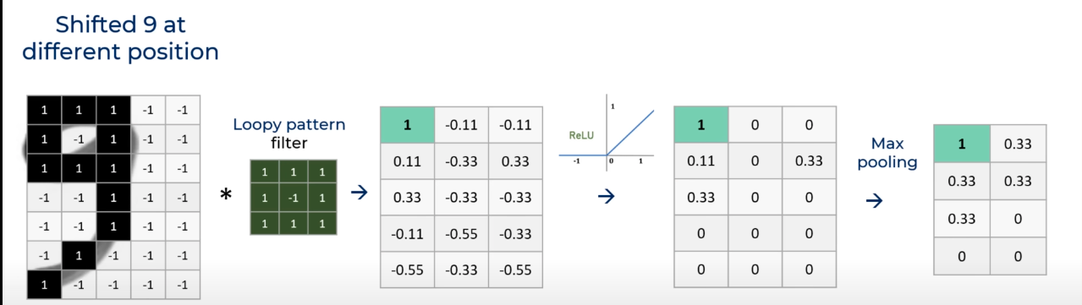
2. Average Pooling

Slide 21
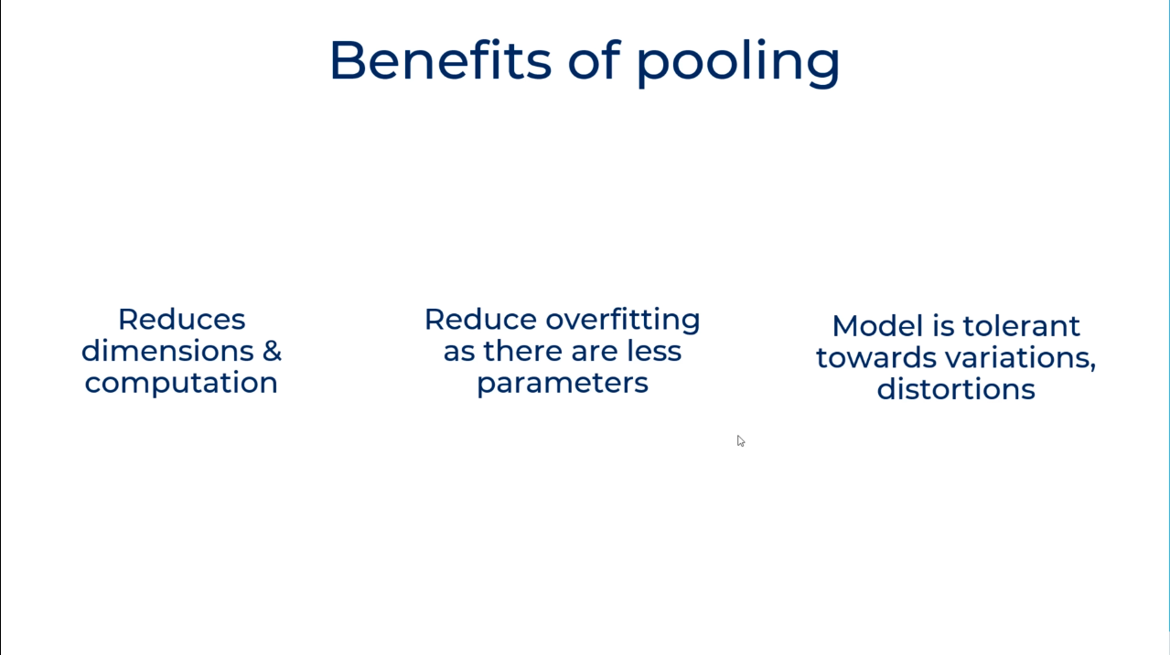

Slide 22
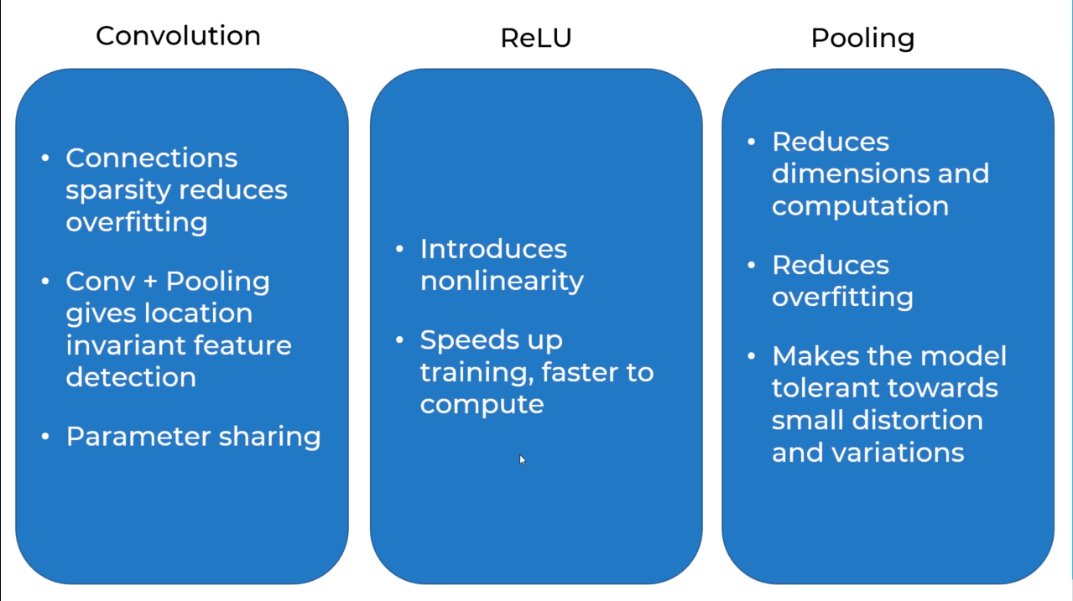

Slide 23
Applications of CNN
Image Recognition – Identifying objects like cats, dogs, or cars in photos
Face Recognition – Unlocking phones with Face ID
Medical Diagnosis – Detecting diseases in X-rays and MRI scans
Self-Driving Cars – Recognizing traffic signs, lanes, and pedestrians.
Handwriting Recognition – Reading handwritten text (e.g., postal addresses, bank checks).
Security Cameras – Detecting suspicious activity automatically.
Farming – Identifying plant diseases and monitoring livestock.

Slide 24
CONCLUSION
Convolutional Neural Networks (CNNs) are powerful deep learning models designed for image and pattern recognition. They consist of key layers like convolutional layers, pooling layers, and fully connected layers, which work together to extract features and classify data efficiently.
CNNs are widely used in image recognition, medical diagnosis, self-driving cars, security, and more. Their ability to automatically learn patterns makes them essential for modern AI applications.

Slide 25
tHank YOU!

